Slide 1

Local ocean weather knowledge
Extraction and application for validation
Matthias Mueller, HBV
Notes:
..of one of the available FjordOs models.

Slide 2
Outline
Motivation
Working Process
Numerical Model
Interview Guide
Local Knowledge
Results
Reflection
Outlook

Slide 3
Motivation (I)
Include local knowledge in the validation of FjordOs models
  To what extent do the ocean weather conditions from the existing model comply with the experience from local people?
  How to generate reliable data and valid conclusions that can support the results from the computer model?
  How to compare experience from local people with results from numerical models?

Slide 4
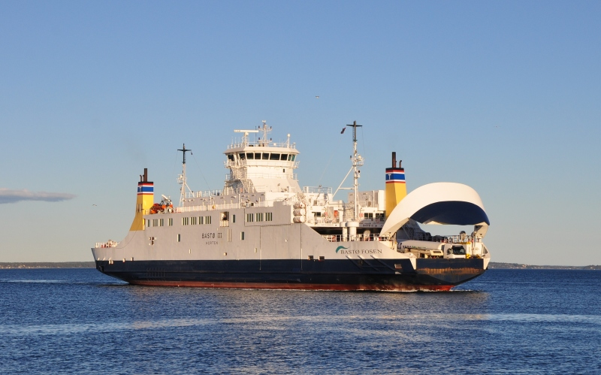
Motivation (II)
Quality of knowledge
Methodological approach as pioneer work
Practice-related research and findings
Effects on shipping

Slide 5
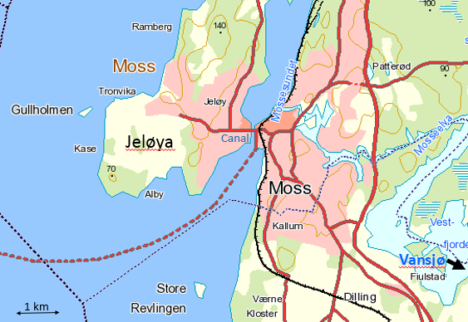
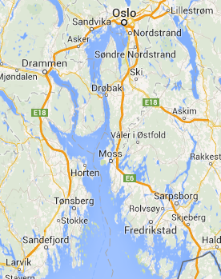
Area of Interest
20 km
20 km
20 km

Slide 6
Working Process
Validation
Analysis
Interview Guide
Verification
Extraction & Selection
Acquisition of local knowledge

Slide 7
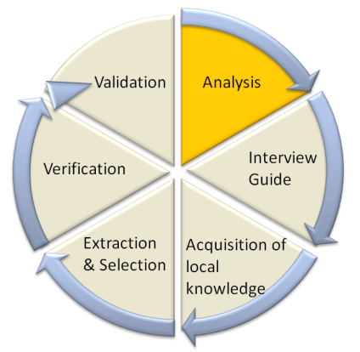
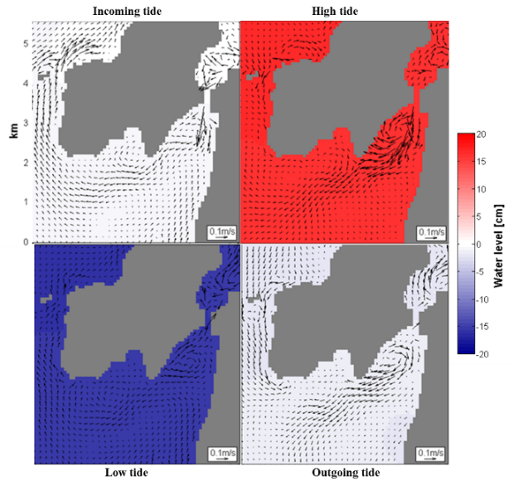
ROMS75 Model

Slide 8
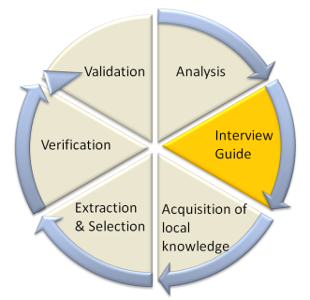
Interview Guide

Slide 9
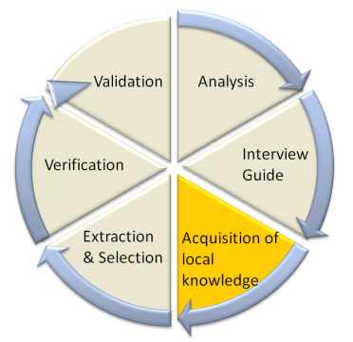
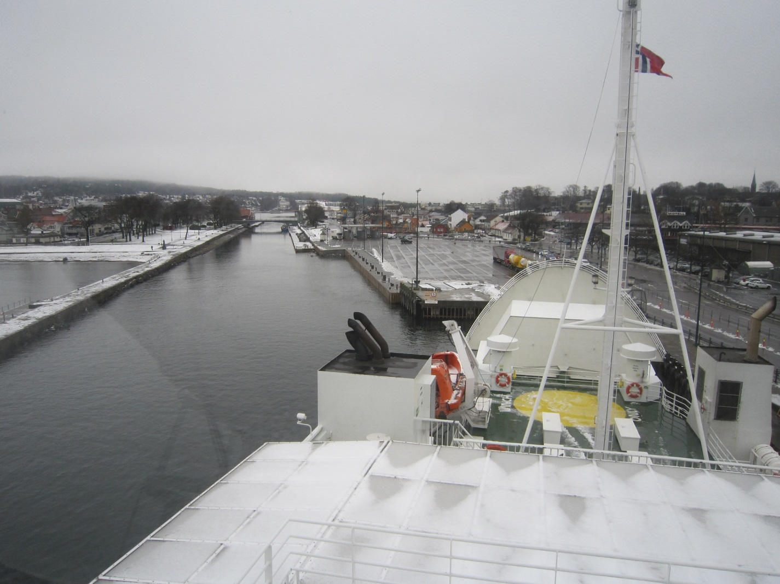
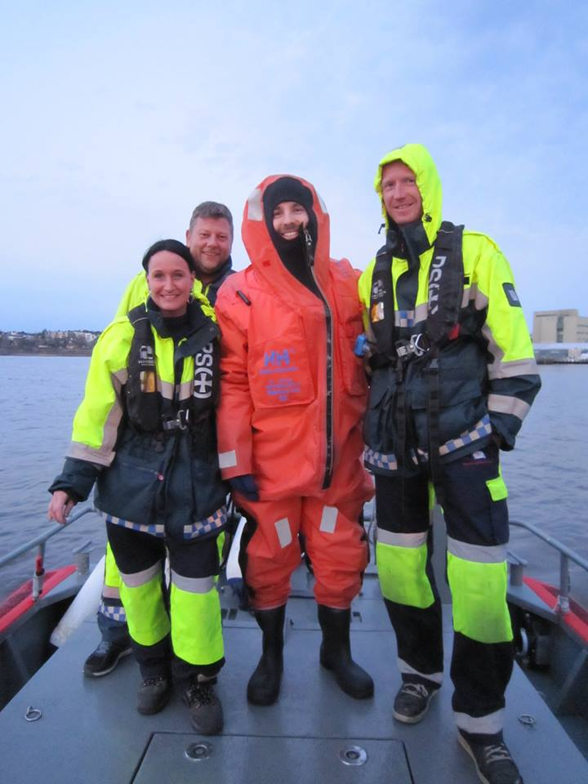
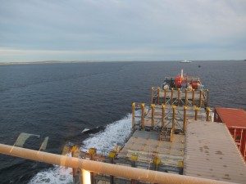
Local Knowledge: Participants
Number of participants | Role domain | Participant | Duration | Location
6 | Captain/ Officer/ Pilot | A1 A2 (two respondents) A3 A4 A5 A6 | 1h 25m 2h 33m 1h 16m 1h 34m abt. 2h 0h 16m | HBV Onboard HBV Office in Moss Onboard¹⁾ Onboard²⁾
2 | Leisure boat sailor | B1 B2 | 1h 27m 0h 58m | Office in Horten
 |  |  |  | HBV
1 | Norwegian Society for Sea Rescue (NSSR) | C1 (three respondents) | 1h 33m | Onboard³⁾
1 | Diver | D1 | 1h 10m | At home of the respondent
1 | Surfer | E1 | 1h 08m | Outside on the coastline of Jeløya⁴⁾
¹⁾ Based on field notes instead of audio recording.
²⁾ Short in time due to on-board duties.
³⁾ Field trip to Revlingen and Mossesundet.
⁴⁾ With the opportunity to observe some of the described phenomena.

Slide 10
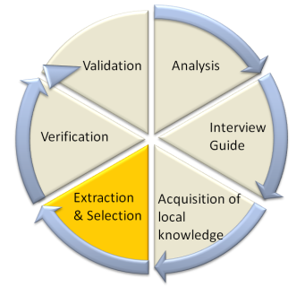
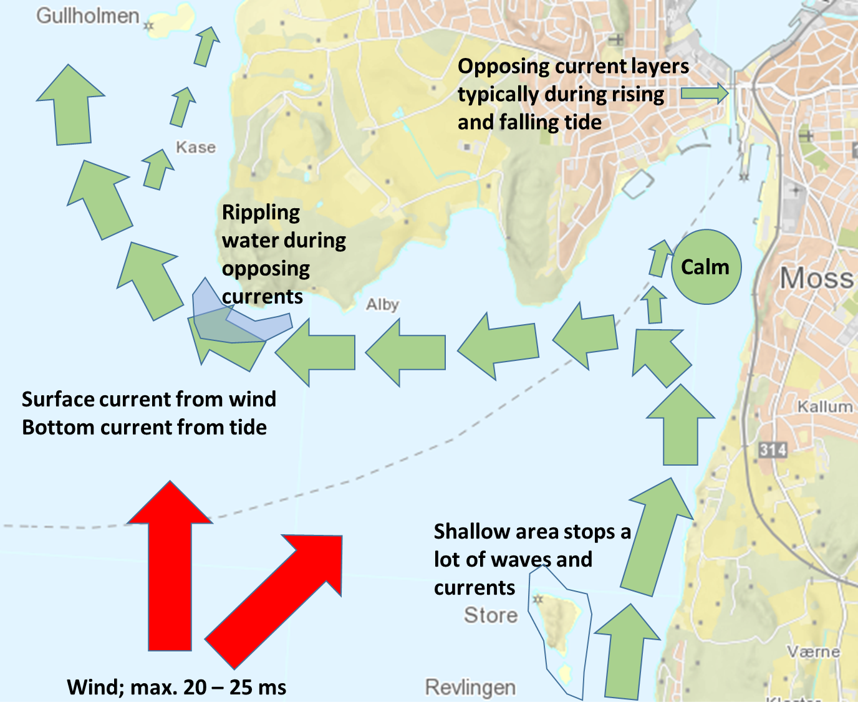
Local Knowledge: Phenomena (I)
NB: Size and direction of arrows is indicative only!

Slide 11
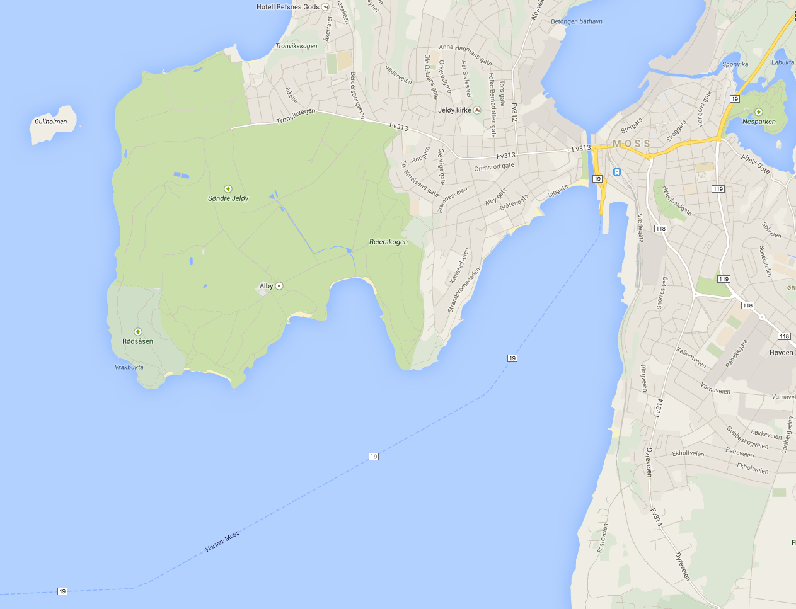
Local Knowledge: Phenomena (II)
NB: Size and direction of arrows is indicative only!
P8
P11
P6

Slide 12
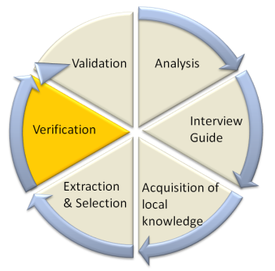



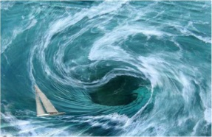

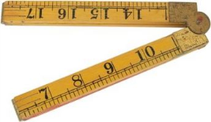
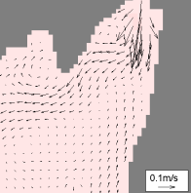
Secondary Sources
Verification of selected phenomena before model validation
 |  |  |  | 
 |  |  | 
 |  |  |  | 

Slide 13
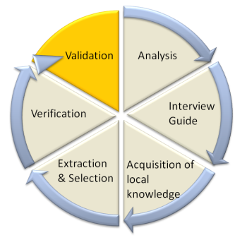
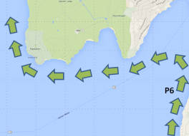
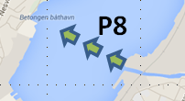
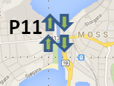
Results
Validation during high, outgoing, low, and incoming tide
Unexpected issues: Revlingen & Vansjø
High tide | - |  | -
Outgoing tide | - |  | 
Low tide |  |  | -
Incoming tide |  |  | -

Slide 14
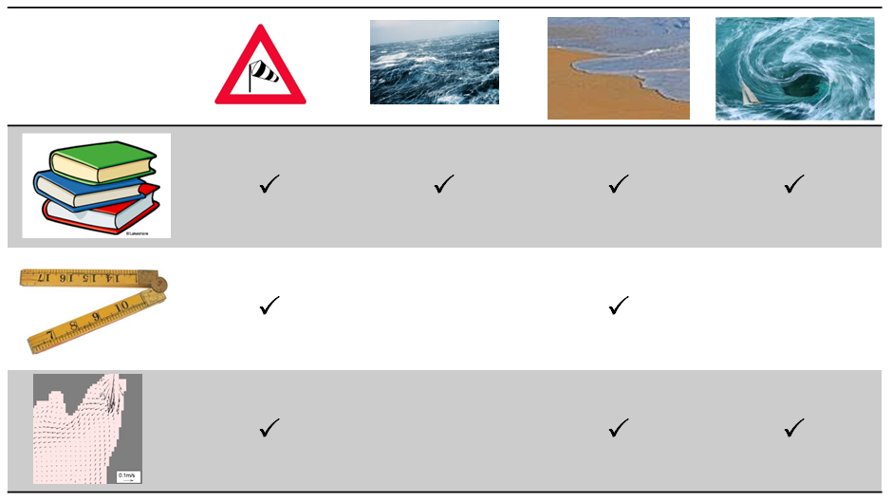
Reflection
Identify new areas of interest
Indicate the capacity
Methodological triangulation for validation quality

Slide 15
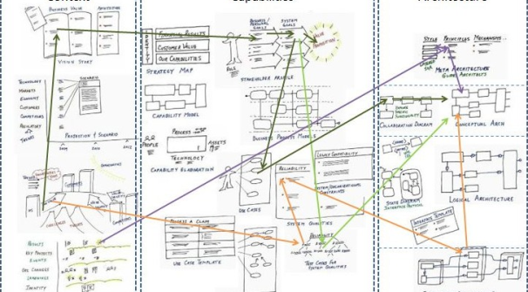

Outlook
Available local knowledge
  Validation with extracted phenomena
  Extraction of further phenomena
Additional local knowledge
  Sample size
  Dynamic process

Slide 16
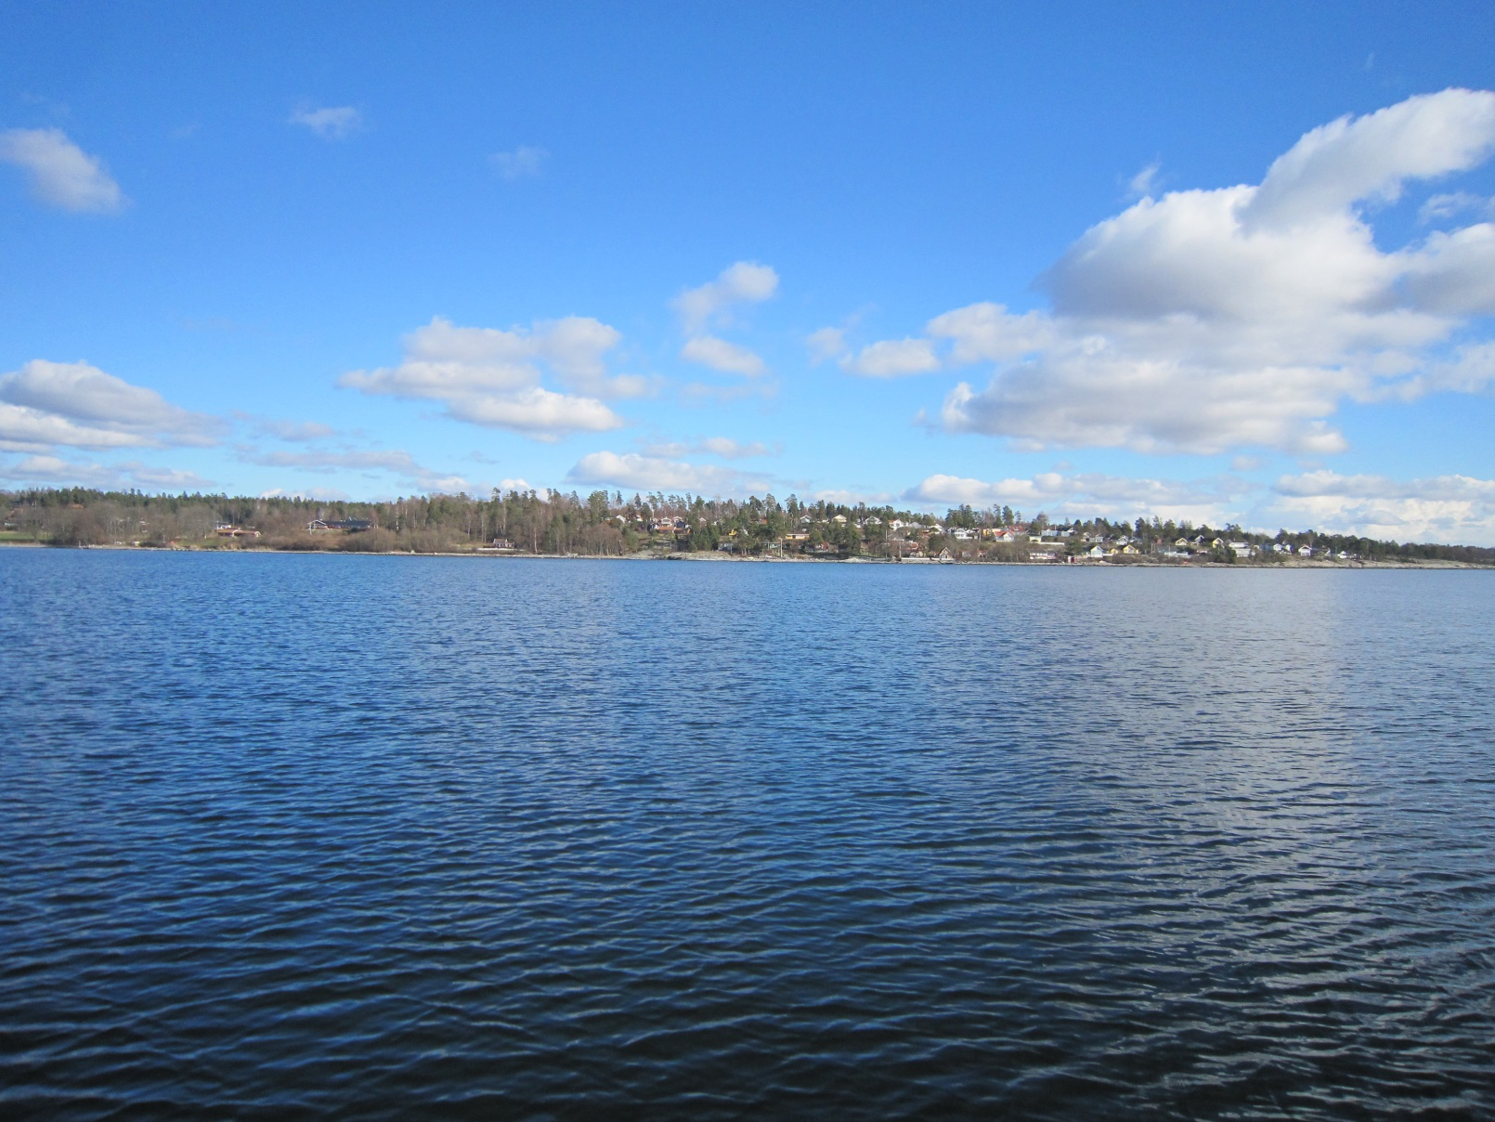
Thank you.

